Slide 1
Smart Water Management
What is IoT Smart Water Management?
IoT-based water management system is a process of planning, allocating, and monitoring water resources and maintaining related equipment like pipes and pumps through IoT hardware and software.
IoT-enabled water management systems use sensors, controllers, meters, and other devices connected to mobile, web apps, and data processing and analysis tools. All this creates a platform for efficient water supply management, freshwater quality checking, pollution detection, and more.

Slide 2
smart water management system work
IoT devices and sensors attached to the pipes and pumps collect real-time data on water temperature, level, flow, etc. Then, they transmit this data via the Internet to a cloud server for further processing and analysis. The insights obtained contribute to proper water resources management and equipment maintenance.
Main Benefits of IoT Water Management Systems
The Internet of Things in smart water management works well for various stakeholders, including businesses, governments, and consumers. It facilitates sustainability and efficiency and provides valuable insights into water resources and associated equipment. Other benefits of IoT-powered smart water management systems for agriculture are as follows:
Real-Time Water Consumption Analysis
Reduced Equipment Maintenance Expenses
Transparency and Better Communication Among Stakeholders
Remote Monitoring
Automation and Optimized Human Resources Use
Reduced Risks

Slide 3
IoT Solutions in Water Management Systems
There are various use cases of IoT water management solutions. Let’s consider the main ones.
1. Smart Irrigation
These IoT-based systems enable on-demand irrigation. They leverage sensors that check soil temperature and humidity, analyze weather forecasts, consider the watering calendar, and suggest the perfect irrigation strategy based on the collected data. Our 2Smart Standalone platform supports smart irrigation features, achieving the best plant health and yields.
2. Water System Integrity
Other solutions in IoT smart water management include sensors that track damage in pipes and other assets. They help prevent leakages and water resource waste. There are plenty of such devices on the market, and Strips Drip by Sensative water leak and temperature sensor is one of them.

Slide 4
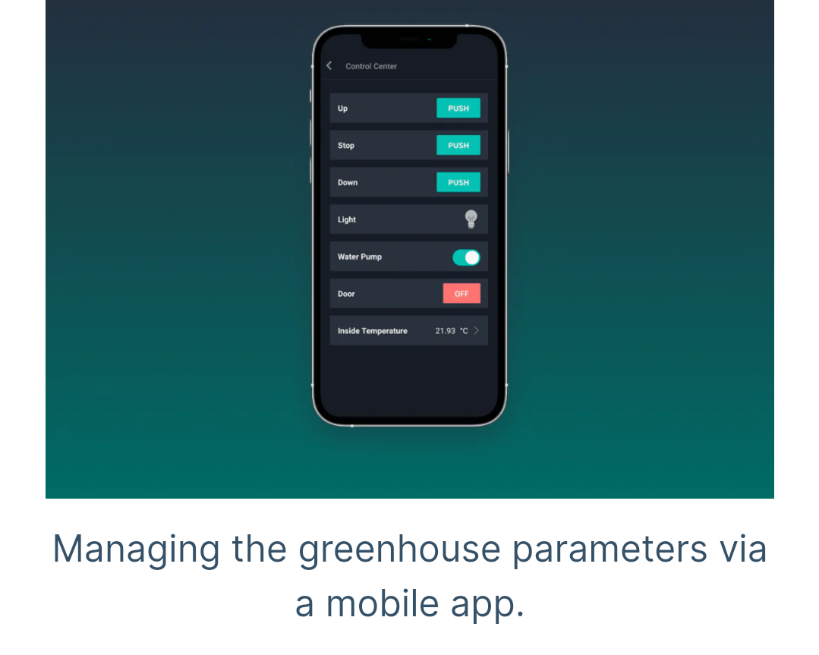
3.Smart Water Monitoring
Smart water monitoring systems include the water system integrity and irrigation features mentioned above. They also involve sensors for determining water quality, telemetry devices, tools for tracking rainwater, etc. All this enables water monitoring and subsequent effective decision-making based on the collected data. Our 2Smart Standalone solution is an example of such a system, as its architecture allows for connecting various water monitoring sensors via any protocol.
4.Smart Water Management
A smart water management system using IoT technology includes various water monitoring devices and sensors combined with advanced data analytics tools. These can be smart metering, user dashboards, and custom solutions for water management automation. For example, 2Smart Standalone enables the creation of limitless automation scenarios like smart irrigation, leakage detection, or support of the required water condition parameters.

Slide 5
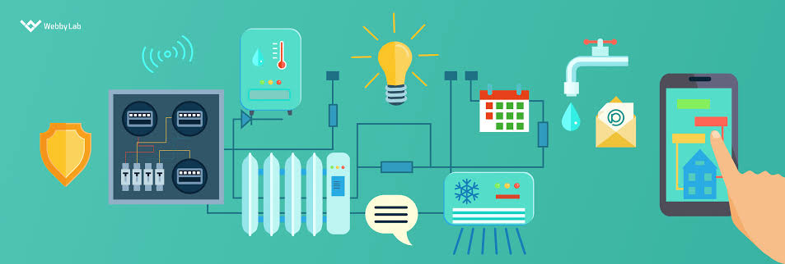
Use Cases of Smart Water Management Systems Using IoT
Applying IoT water management solutions in many sectors – from agriculture to urban management. Let’s look at some real-life examples of these technologies
1)Monitoring the Quality of River Water
2) Smart Dam Monitoring

